Slide 1
Statistics - IV

Slide 2
Testing Hypothesis

Slide 3
Topics
Gaussian or Normal distribution
ROC Curve
PDF
CDF
Summary Statistics
T Distribution
Chi squared distribibutions

Slide 4
Probability Density Distributions

Slide 5
Probability distribution
In probability theory and statistics, a probability distribution is a mathematical function that, stated in simple terms, can be thought of as providing the probabilities of occurrence of different possible outcomes in an experiment. For instance, if the random variable X is used to denote the outcome of a coin toss ("the experiment"), then the probability distribution of X would take the value 0.5 for X = heads, and 0.5 for X = tails (assuming the coin is fair).

Slide 6
Discrete and Continuous Probability Distributions
A discrete probability distribution (applicable to the scenarios where the set of possible outcomes is discrete, such as a coin toss or a roll of dice) can be encoded by a discrete list of the probabilities of the outcomes, known as a probability mass function.
A continuous probability distribution (applicable to the scenarios where the set of possible outcomes can take on values in a continuous range (e.g. real numbers), such as the temperature on a given day) is typically described by probability density functions
The normal distribution is a commonly encountered continuous probability distribution. More complex experiments, such as those involving stochastic processes defined in continuous time, may demand the use of more general probability measures.

Slide 7
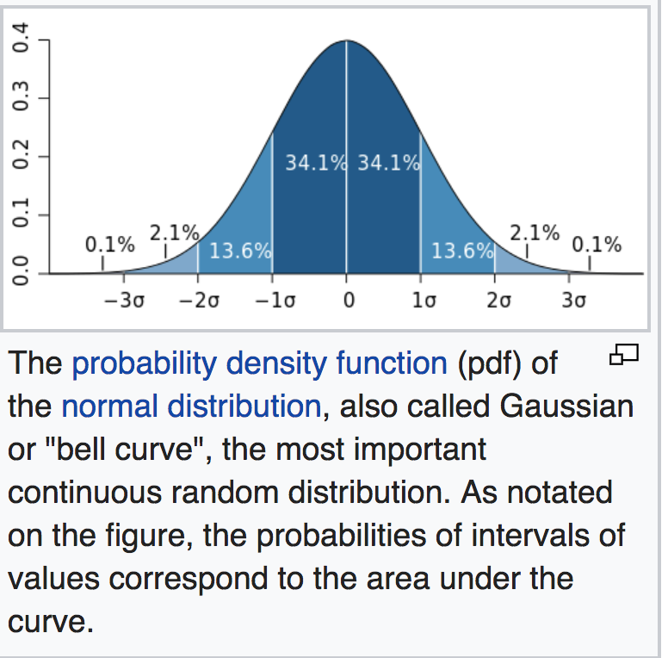

Slide 8
Terms
Null and Alternative Hypotheses
Test Statistic
P-Value
Significance Level
One-Sample z Test
Power and Sample Size

Slide 9
Other terms
Population ≡ all possible values
Sample ≡ a portion of the population
Statistical inference ≡ generalizing from a sample to a population with calculated degree of certainty
Two forms of statistical inference
Hypothesis testing
Estimation
Parameter ≡ a characteristic of population, e.g., population mean µ
Statistic ≡ calculated from data in the sample, e.g., sample mean
Notes:
Hypothesis testing is one of the two common forms of statistical inference. This slide reviews some of the terms that form the basis of statistical inference, as introduced in the prior chapter. Make certain you understand these basics before proceeding.

Slide 10
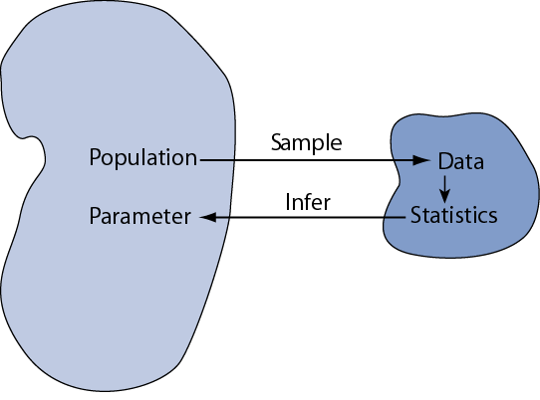

Slide 11
Hypothesis Testing

Slide 12
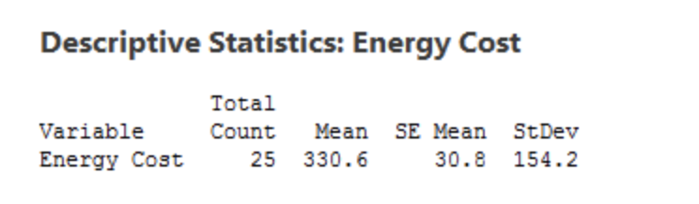
Why we need Hypothesis Tests?
An economist wants to determine whether the monthly energy cost for families has changed from the previous year, when the mean cost per month was $260. The economist randomly samples 25 families and records their energy costs for the current year.
Sample Mean : 330.6$
Population mean : 260 $

Slide 13
The need for hypothesis tests
We took a random sample and our sample mean of 330.6 is different from 260. That is different, right?
Unfortunately, the picture is muddied because we’re looking at a sample rather than the entire population.
Sampling error is the difference between a sample and the entire population.
Thanks to sampling error, it’s entirely possible that while our sample mean is 330.6, the population mean could still be 260.
Or, to put it another way, if we repeated the experiment, it’s possible that the second sample mean could be close to 260.
A hypothesis test helps assess the likelihood of this possibility!

Slide 14
Steps for Hypothesis Testing
Formulate H₀ and H₁
Select Appropriate Test
Choose Level of Significance
Calculate Test Statistic TS_{CAL}
Determine Prob Assoc with Test Stat
Determine Critical Value of Test Stat
TS_{CR}
Determine if TS_{CR}
falls into (Non) Rejection Region
Compare with Level of Significance, α
Reject/Do not Reject H₀
Draw Marketing Research Conclusion

Slide 15
Step 1: Formulate the Hypothesis
A null hypothesis is a statement of the status quo, one of no difference or no effect. If the null hypothesis is not rejected, no changes will be made.
An alternative hypothesis is one in which some difference or effect is expected.

Slide 16
Example of a Hypothesis Test
For the data in Table 15.1, suppose we wanted to test
the hypothesis that the mean familiarity rating exceeds
4.0, the neutral value on a 7 point scale. A significance
level of = 0.05 is selected. The hypotheses may be
formulated as:
α
H₀:
< 4.0
H₁:
> 4.0
t_{CAL} = (4.724-4.0)/0.293 = 2.471
= 0.293

Slide 17
One Sample : t Test
The df for the t stat is n - 1. In this case, n - 1 = 28.
The probability assoc with 2.471 is less than 0.05. So the null hypothesis is rejected
Alternatively, the critical t_{α} value for a significance level of 0.05 is 1.7011
Since, 1.7011 <2.471, the null hypothesis is rejected.
The familiarity level does exceed 4.0.
Note that if the population standard deviation was known to be 1.5, rather than estimated from the sample, a z test would be appropriate.

Slide 18
Step 1: Formulate the Hypothesis
A null hypothesis may be rejected, but it can never be accepted based on a single test.
In marketing research, the null hypothesis is formulated in such a way that its rejection leads to the acceptance of the desired conclusion.
A new Internet Shopping Service will be introduced if more than 40% people use it:
H
:
π
≤
0
.
4
0
0
H
1
:
π
>
0
.
40

Slide 19
Step 1: Formulate the Hypothesis
In eg on previous slide, the null hyp is a one-tailed test, because the alternative hypothesis is expressed directionally.
If not, then a two-tailed test would be required as foll:
H
:
π
=
0
.
4
0
0
H
:
π
≠
0
.
4
0
1

Slide 20
Step 2: Select an Appropriate Test
The test statistic measures how close the sample has come to the null hypothesis.
The test statistic often follows a well-known distribution (eg, normal, t, or chi-square).
In our example, the z statistic, which follows the standard normal distribution, would be appropriate.
p
-
π
z
=
σ
p
Where σ_{p} is standard deviation

Slide 21
Step 3: Choose Level of Significance
Type I Error
Occurs if the null hypothesis is rejected when it is in fact true.
The probability of type I error ( α ) is also called the level of significance.
Type II Error
Occurs if the null hypothesis is not rejected when it is in fact false.
The probability of type II error is denoted by β .
Unlike α, which is specified by the researcher, the magnitude of β depends on the actual value of the population parameter (proportion).
It is necessary to balance the two types of errors.

Slide 22
Step 3: Choose Level of Significance
Power of a Test
The power of a test is the probability (1 - β) of rejecting the null hypothesis when it is false and should be rejected.
Although β is unknown, it is related to α. An extremely low value of α (e.g., = 0.001) will result in intolerably high β errors.

Slide 23
Probability of z with a One-Tailed Test
Shaded Area
= 0.9699
Unshaded Area
= 0.0301
0
z_{CAL} = 1.88

Slide 24
Step 4: Collect Data and Calculate Test Statistic
The required data are collected and the value of the test statistic computed.
In our example, 30 people were surveyed and 17 shopped on the internet. The value of the sample proportion is = 17/30 = 0.567.
σ
=0.089
p

Slide 25
Step 4: Collect Data and Calculate Test Statistic
The test statistic z can be calculated as follows:
ˆ
−
π
p
z_{CAL}
=
σ
p
= 0.567-0.40
0.089
= 1.88

Slide 26
Step 5: Determine Probability Value/ Critical Value
Using standard normal tables (Table 2 of the Statistical Appendix), the area to the right of z_{CAL} is .0301 (z_{CAL} =1.88)
The shaded area between 0 and 1.88 is 0.4699. Therefore, the area to the right of 1.88 is 0.5 - 0.4699 = 0.0301.
Thus, the p-value is .0301
Alternatively, the critical value of z, called z_{α}, which will give an area to the right side of the critical value of α=0.05, is between 1.64 and 1.65. Thus z_{α} =1.645.
Note, in determining the critical value of the test statistic, the area to the right of the critical value is either α or α/2. It is α for a one-tail test and α/2 for a two-tail test.

Slide 27
Steps 6 & 7: Compare Prob and Make the Decision
If the prob associated with the calculated value of the test statistic ( z_{CAL}) is less than the level of significance (α), the null hypothesis is rejected.
In our case, the p-value is 0.0301.This is less than the level of significance of α =0.05. Hence, the null hypothesis is rejected.
Alternatively, if the calculated value of the test statistic is greater than the critical value of the test statistic ( z_{α}), the null hypothesis is rejected.

Slide 28
Steps 6 & 7: Compare Prob and Make the Decision
The calculated value of the test statistic z_{CAL}= 1.88 lies in the rejection region, beyond the value of z_{α}=1.645. Again, the same conclusion to reject the null hypothesis is reached.
Note that the two ways of testing the null hypothesis are equivalent but mathematically opposite in the direction of comparison.
Writing Test-Statistic as TS:
If the probability of TS_{CAL} < significance level ( α ) then reject H₀ but if TS_{CAL} > TS_{CR} then reject H₀.

Slide 29
Step 8: Mkt Research Conclusion
The conclusion reached by hypothesis testing must be expressed in terms of the marketing research problem.
In our example, we conclude that there is evidence that the proportion of Internet users who shop via the Internet is significantly greater than 0.40. Hence, the department store should introduce the new Internet shopping service.

Slide 30
Using a t-Test
Assume that the random variable X is normally dist, with unknown pop variance estimated by the sample variance s ².
Then a t test is appropriate.
The t-statistic, is t distributed with n - 1 df.
The t dist is similar to the normal distribution: bell-shaped and symmetric. As the number of df increases, the t dist approaches the normal dist.
t
=
(
X
-
μ
)
/
s
X

Slide 31
Broad Classification of Hyp Tests
Hypothesis Tests
Tests of Association
Tests of Differences
Means
Proportions
Means
Proportions

Slide 32
Hypothesis Testing for Differences
Hypothesis Tests
Parametric Tests (Metric)
Non-parametric Tests (Nonmetric)
One Sample
Two or More Samples
* t test
* Z test
Independent Samples
* Two-Group t test
* Z test
* Paired
t test

Slide 33
Two Independent Samples: Means
In the case of means for two independent samples, the hypotheses take the following form.
The two populations are sampled and the means and variances computed based on samples of sizes n1 and n2.
The idea behind the test is similar to the test for a single mean, though the formula for standard error is different
Suppose we want to determine if internet usage is different for males than for females, using data in Table 15.1

Slide 34
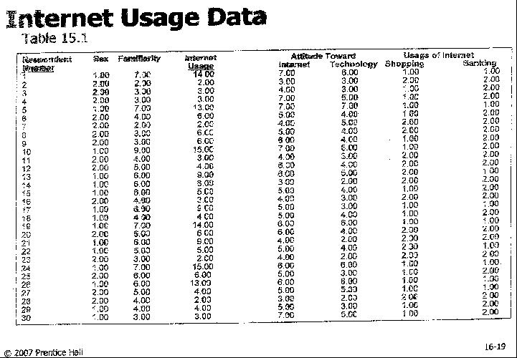

Slide 35
Two Independent-Samples: t Tests
Table 15.14
-

Slide 36
Two Independent Samples: Proportions
Consider data of previous table
Is the proportion of respondents using the Internet for shopping the same for males and females? The null and alternative hypotheses are:
The test statistic is similar to the one for difference of means, with a different formula for standard error.

Slide 37
Summary of Hypothesis Tests for Differences
Sample
Application
Level of Scaling
Test/Comments
One Sample
Proportion
Metric
Z test
One Sample
Means
Metric
t
test, if variance is unknown
z
test, if variance is known

Slide 38
Summary of Hypothesis Tests for Differences
Two Indep Samples
Application
Scaling
Test/Comments
Two indep samples
Means
Metric
Two
-
group
t
test
F
test for equality of
variances
Two indep samples
Proportions
Metric
z
test
Nonmetric
Chi
-
square test

Slide 39
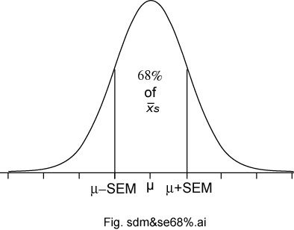
Sampling Distributions of a Mean
The sampling distributions of a mean (SDM) describes the behavior of a sampling mean
Notes:
This slide summarize what we’ve learned about the sampling distribution of a mean from a large sample. It is based no three important sampling postulates: the central limit theorem, the law of large numbers (unbiased nature of the sample mean), and square root law. Based on these well established statistical theorems we can say that means based on large samples (and means based in Normal populations) will have a Normal sampling distribution with an expectation equal to the population mean with a standard deviation equal to the standard deviation of the population divided by the square root of the sample size n.

Slide 40
Example
Lets start with a mean, like height of students
Heights follow a bell curve
Let’s say average height is 5 ‘6’’
If there are 10 classes of students, average will vary around 5’6’’
CLT says that if you have a lot of data, this averages also look like a bell curve

Slide 41
Hypothesis Testing
Is also called significance testing
Tests a claim about a parameter using evidence (data in a sample)
The technique is introduced by considering a one-sample z test
The procedure is broken into four steps
Each element of the procedure must be understood
Notes:
Hypothesis testing (also called significance testing) uses a quasi-deductive procedure to judge claims about parameters. Before testing a statistical hypothesis it is important to clearly state the nature of the claim to be tested. We are then going to use a four step procedure (as outlined in the last bullet) to test the claim.

Slide 42
Hypothesis Testing Steps
Null and alternative hypotheses
Test statistic
P-value and interpretation
Significance level (optional)

Slide 43
Null and Alternative Hypotheses
Convert the research question to null and alternative hypotheses
The null hypothesis (H₀) is a claim of “no difference in the population”
The alternative hypothesis (H_{a}) claims “H₀ is false”
Collect data and seek evidence against H₀ as a way of bolstering H_{a} (deduction)
Notes:
The first step in the procedure is to state the hypotheses null and alternative forms. The null hypothesis (abbreviate “H naught”) is a statement of no difference. The alternative hypothesis (“H sub a”) is a statement of difference. Seek evidence against the claim of H₀ as a way of bolstering H_{a.}
The next slide offers an illustrative example on setting up the hypotheses.

Slide 44
Example: “Body Weight”
The problem: In the 1970s, 20–29 year old men in the U.S. had a mean μ body weight of 170 pounds. Standard deviation σ was 40 pounds. We test whether mean body weight in the population now differs.
Null hypothesis H_{0:} μ = 170 (“no difference”)
The alternative hypothesis can be either H_{a:} μ > 170 (one-sided test) or H_{a:} μ ≠ 170 (two-sided test)
Notes:
In the late 1970s, the weight of U.S. men between 20- and 29-years of age had a log-normal distribution with a mean of 170 pounds and standard deviation of 40 pounds. As you know, the overweight and obese conditions seems to be more prevalent today, constituting a major public health problem. To illustrate the hypothesis testing procedure, we ask if body weight in this group has increased since 1970. Under the null hypothesis there is no difference in the mean body weight between then and now, in which case μ would still equal 170 pounds.
Under the alternative hypothesis, the mean weight has increased Therefore, H_{a:} μ > 170. This statement of the alternative hypothesis is one-sided. That is, it looks only for values larger than stated under the null hypothesis.
There is another way to state the alternative hypothesis. We could state it in a “two-sided” manner, looking for values that are either higher- or lower-than expected. For the current illustrative example, the two-sided alternative is H_{a:} μ ≠ 170. Although for the current illustrative example, this seems unnecessary, two-sided alternative offers several advantages and are much more common in practice.

Slide 45
Test Statistic
This is an example of a one-sample test of a mean when σ is known. Use this statistic to test the problem:

Slide 46
Illustrative Example: z statistic
For the illustrative example, μ₀ = 170
We know σ = 40
Take an SRS of n = 64. Therefore
If we found a sample mean of 173, then

Slide 47
Illustrative Example: z statistic
If we found a sample mean of 185, then

Slide 48
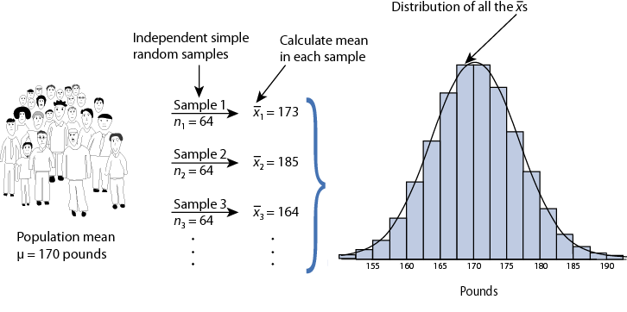
Reasoning Behind µz_{stat}
Sampling distribution of xbar under H₀: µ = 170 for n = 64 ⇒

Slide 49
P-value
The P-value answer the question: What is the probability of the observed test statistic or one more extreme when H₀ is true?
This corresponds to the AUC in the tail of the Standard Normal distribution beyond the z_{stat.}
Convert z statistics to P-value :
For H_{a}: μ > μ₀ ⇒ P = Pr(Z > z_{stat}) = right-tail beyond z_{stat}
For H_{a}: μ < μ₀ ⇒ P = Pr(Z < z_{stat}) = left tail beyond z_{stat}
For H_{a}: μ ≠ μ₀ ⇒ P = 2 × one-tailed P-value
Use Table B or software to find these probabilities (next two slides).

Slide 50
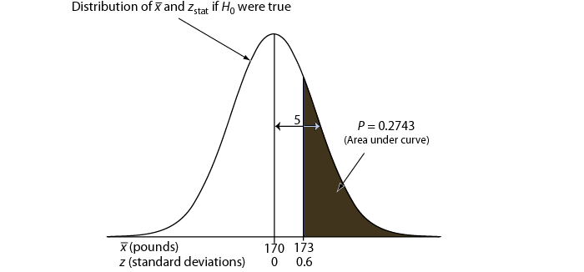
One-sided P-value for z_{stat} of 0.6

Slide 51
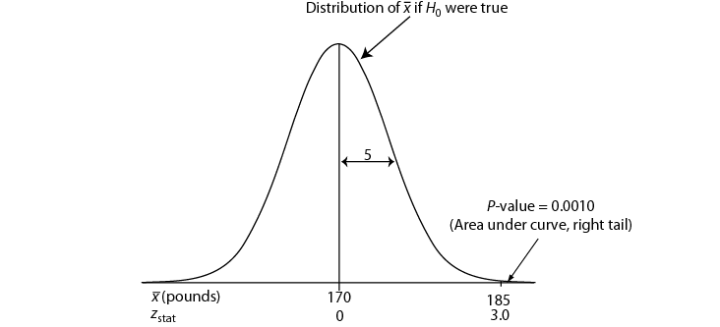
One-sided P-value for z_{stat} of 3.0

Slide 52
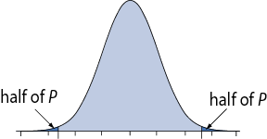
Two-Sided P-Value
One-sided H_{a} ⇒ AUC in tail beyond z_{stat}
Two-sided H_{a} ⇒ consider potential deviations in both directions ⇒ double the one-sided P-value
Examples: If one-sided P = 0.0010, then two-sided P = 2 × 0.0010 = 0.0020. If one-sided P = 0.2743, then two-sided P = 2 × 0.2743 = 0.5486.

Slide 53
Interpretation
P-value answer the question: What is the probability of the observed test statistic … when H₀ is true?
Thus, smaller and smaller P-values provide stronger and stronger evidence against H₀
Small P-value ⇒ strong evidence

Slide 54
Interpretation
Conventions*
P > 0.10 ⇒ non-significant evidence against H₀
0.05 < P ≤ 0.10 ⇒ marginally significant evidence
0.01 < P ≤ 0.05 ⇒ significant evidence against H₀
P ≤ 0.01 ⇒ highly significant evidence against H₀
Examples
P =.27 ⇒ non-significant evidence against H₀
P =.01 ⇒ highly significant evidence against H₀
* It is unwise to draw firm borders for “significance”

Slide 55
α-Level (Used in some situations)
Let α ≡ probability of erroneously rejecting H₀
Set α threshold (e.g., let α = .10, .05, or whatever)
Reject H₀ when P ≤ α
Retain H₀ when P > α
Example: Set α = .10. Find P = 0.27 ⇒ retain H₀
Example: Set α = .01. Find P = .001 ⇒ reject H₀

Slide 56
(Summary) One-Sample z Test
Hypothesis statements H₀: µ = µ₀ vs. H_{a}: µ ≠ µ₀ (two-sided) or H_{a}: µ < µ₀ (left-sided) or H_{a}: µ > µ₀ (right-sided)
Test statistic
P-value: convert z_{stat} to P value
Significance statement (usually not necessary)

Slide 57
Conditions for z test
σ known (not from data)
Population approximately Normal or large sample (central limit theorem)
Data valid

Slide 58
The Lake Wobegon Example “where all the children are above average”
Let X represent Weschler Adult Intelligence scores (WAIS)
Typically, X ~ N(100, 15)
Take SRS of n = 9 from Lake Wobegon population
Data ⇒ {116, 128, 125, 119, 89, 99, 105, 116, 118}
Calculate: x-bar = 112.8
Does sample mean provide strong evidence that population mean μ > 100?

Slide 59
Example: “Lake Wobegon”
Hypotheses: H₀: µ = 100 versus H_{a}: µ > 100 (one-sided) H_{a}: µ ≠ 100 (two-sided)
Test statistic:

Slide 60
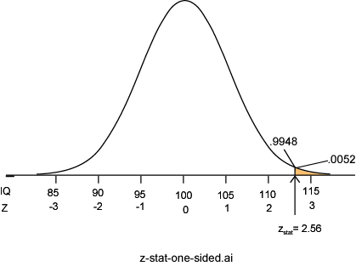
C. P-value: P = Pr(Z ≥ 2.56) = 0.0052
P =.0052 ⇒ it is unlikely the sample came from this null distribution ⇒ strong evidence against H₀

Slide 61
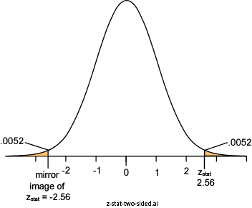
Two-Sided P-value: Lake Wobegon
H_{a}: µ ≠100
Considers random deviations “up” and “down” from μ₀ ⇒tails above and below ±z_{stat}
Thus, two-sided P = 2 × 0.0052 = 0.0104

Slide 62
Power and Sample Size
Two types of decision errors:
Type I error = erroneous rejection of true H₀
Type II error = erroneous retention of false H₀
 | Truth
Decision | H₀ true | H₀ false
Retain H₀ | Correct retention | Type II error
Reject H₀ | Type I error | Correct rejection
α ≡ probability of a Type I error
β ≡ Probability of a Type II error

Slide 63
Power
β ≡ probability of a Type II error
β = Pr(retain H₀ | H₀ false) (the “|” is read as “given”)
1 – β = “Power” ≡ probability of avoiding a Type II error 1– β = Pr(reject H₀ | H₀ false)

Slide 64
Power of a z test
where
Φ(z) represent the cumulative probability of Standard Normal Z
μ₀ represent the population mean under the null hypothesis
μ_{a} represents the population mean under the alternative hypothesis
with
.

Slide 65
Calculating Power: Example
A study of n = 16 retains H₀: μ = 170 at α = 0.05 (two-sided); σ is 40. What was the power of test’s conditions to identify a population mean of 190?

Slide 66
Reasoning Behind Power
Competing sampling distributions
Top curve (next page) assumes H₀ is true
Bottom curve assumes H_{a} is true
α is set to 0.05 (two-sided)
We will reject H₀ when a sample mean exceeds 189.6 (right tail, top curve)
The probability of getting a value greater than 189.6 on the bottom curve is 0.5160, corresponding to the power of the test

Slide 67
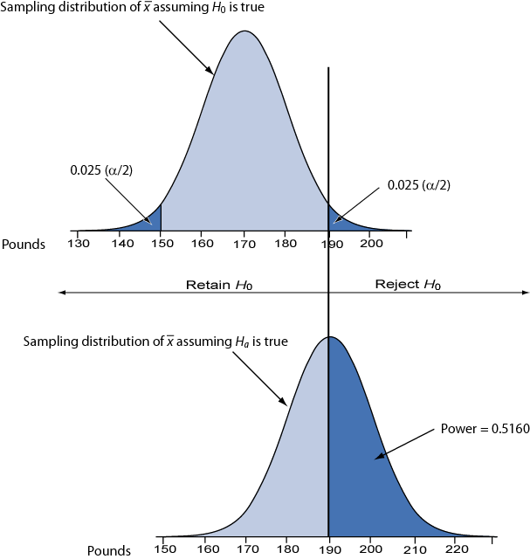

Slide 68
Sample Size Requirements
Sample size for one-sample z test:
where
1 – β ≡ desired power
α ≡ desired significance level (two-sided)
σ ≡ population standard deviation
Δ = μ₀ – μ_{a} ≡ the difference worth detecting

Slide 69
Example: Sample Size Requirement
How large a sample is needed for a one-sample z test with 90% power and α = 0.05 (two-tailed) when σ = 40? Let H₀: μ = 170 and H_{a}: μ = 190 (thus, Δ = μ₀ − μ_{a} = 170 – 190 = −20)
Round up to 42 to ensure adequate power.

Slide 70
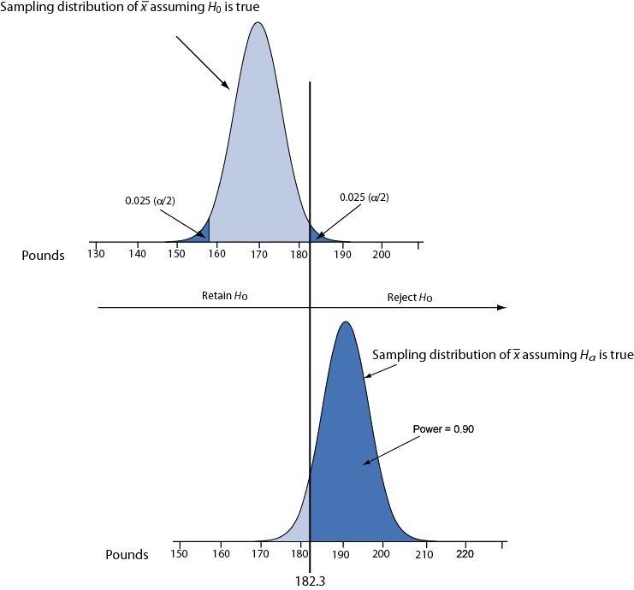
Illustration: conditions for 90% power.

Slide 71
Hypothesis Testing
Goal: Make statement(s) regarding unknown population parameter values based on sample data
Elements of a hypothesis test:
Null hypothesis - Statement regarding the value(s) of unknown parameter(s). Typically will imply no association between explanatory and response variables in our applications (will always contain an equality)
Alternative hypothesis - Statement contradictory to the null hypothesis (will always contain an inequality)
Test statistic - Quantity based on sample data and null hypothesis used to test between null and alternative hypotheses
Rejection region - Values of the test statistic for which we reject the null in favor of the alternative hypothesis

Slide 72
Hypothesis Testing
Goal: Keep α, β reasonably small

Slide 73
Example - Efficacy Test for New drug
Drug company has new drug, wishes to compare it with current standard treatment
Federal regulators tell company that they must demonstrate that new drug is better than current treatment to receive approval
Firm runs clinical trial where some patients receive new drug, and others receive standard treatment
Numeric response of therapeutic effect is obtained (higher scores are better).
Parameter of interest: μ_{New} - μ_{Std}

Slide 74
Example - Efficacy Test for New drug
Null hypothesis - New drug is no better than standard trt
Alternative hypothesis - New drug is better than standard trt
Experimental (Sample) data:

Slide 75
Sampling Distribution of Difference in Means
In large samples, the difference in two sample means is approximately normally distributed:
Under the null hypothesis, μ₁-μ₂=0 and:
σ₁² and σ₂² are unknown and estimated by s₁² and s₂²

Slide 76
Example - Efficacy Test for New drug
Type I error - Concluding that the new drug is better than the standard (H_{A}) when in fact it is no better (H₀). Ineffective drug is deemed better.
Traditionally α = P(Type I error) = 0.05
Type II error - Failing to conclude that the new drug is better (H_{A}) when in fact it is. Effective drug is deemed to be no better.
Traditionally a clinically important difference (Δ) is assigned and sample sizes chosen so that:
β = P(Type II error | μ₁-μ₂ = Δ) ≤ .20

Slide 77
Elements of a Hypothesis Test
Test Statistic - Difference between the Sample means, scaled to number of standard deviations (standard errors) from the null difference of 0 for the Population means:
Rejection Region - Set of values of the test statistic that are consistent with H_{A}, such that the probability it falls in this region when H₀ is true is α (we will always set α=0.05)

Slide 78
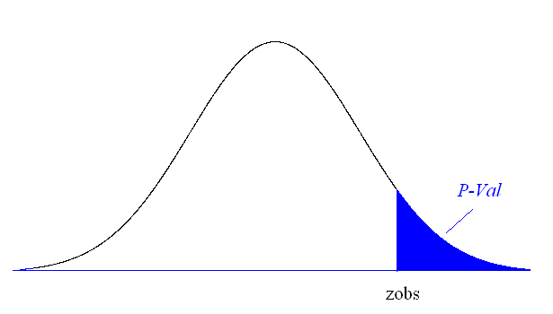
P-value (aka Observed Significance Level)
P-value - Measure of the strength of evidence the sample data provides against the null hypothesis:
P(Evidence This strong or stronger against H₀ | H₀ is true)

Slide 79
Large-Sample Test H₀:μ₁-μ₂=0 vs H₀:μ₁-μ₂>0
H₀: μ₁-μ₂ = 0 (No difference in population means
H_{A}: μ₁-μ₂ > 0 (Population Mean 1 > Pop Mean 2)
Conclusion - Reject H₀ if test statistic falls in rejection region, or equivalently the P-value is ≤ α

Slide 80
Example - Botox for Cervical Dystonia
Patients - Individuals suffering from cervical dystonia
Response - Tsui score of severity of cervical dystonia (higher scores are more severe) at week 8 of Tx
Research (alternative) hypothesis - Botox A decreases mean Tsui score more than placebo
Groups - Placebo (Group 1) and Botox A (Group 2)
Experimental (Sample) Results:
Source: Wissel, et al (2001)

Slide 81
Example - Botox for Cervical Dystonia
Test whether Botox A produces lower mean Tsui scores than placebo (α = 0.05)
Conclusion: Botox A produces lower mean Tsui scores than placebo (since 2.82 > 1.645 and P-value < 0.05)

Slide 82
2-Sided Tests
Many studies don’t assume a direction wrt the difference μ₁-μ₂
H₀: μ₁-μ₂ = 0 H_{A}: μ₁-μ₂ ≠ 0
Test statistic is the same as before
Decision Rule:
Conclude μ₁-μ₂ > 0 if z_{obs} ≥ z_{α/2} (α=0.05 ⇒ z_{α/2}=1.96)
Conclude μ₁-μ₂ < 0 if z_{obs} ≥ -z_{α/2} (α=0.05 ⇒ -z_{α/2}= -1.96)
Do not reject μ₁-μ₂ = 0 if -z_{α/2} ≤ z_{obs} ≤ z_{α/2}
P-value: 2P(Z≥ |z_{obs}|)

Slide 83
Power of a Test
Power - Probability a test rejects H₀ (depends on μ₁- μ₂)
H₀ True: Power = P(Type I error) = α
H₀ False: Power = 1-P(Type II error) = 1-β
Example:
H₀: μ₁- μ₂ = 0 H_{A}: μ₁- μ₂ > 0
σ₁² = σ₂² = 25 n₁ = n₂ = 25
Decision Rule: Reject H₀ (at α=0.05 significance level) if:

Slide 84
Power of a Test
Now suppose in reality that μ₁-μ₂ = 3.0 (H_{A} is true)
Power now refers to the probability we (correctly) reject the null hypothesis. Note that the sampling distribution of the difference in sample means is approximately normal, with mean 3.0 and standard deviation (standard error) 1.414.
Decision Rule (from last slide): Conclude population means differ if the sample mean for group 1 is at least 2.326 higher than the sample mean for group 2
Power for this case can be computed as:

Slide 85
Power of a Test
All else being equal:
As sample sizes increase, power increases
As population variances decrease, power increases
As the true mean difference increases, power increases

Slide 86
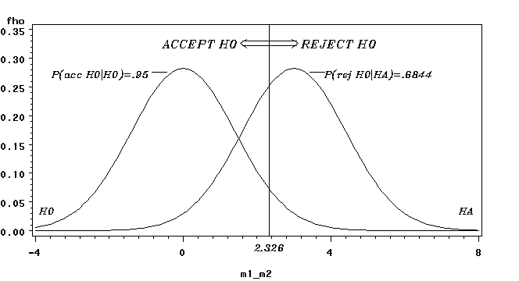
Power of a Test
Distribution (H₀)
Distribution (H_{A})

Slide 87
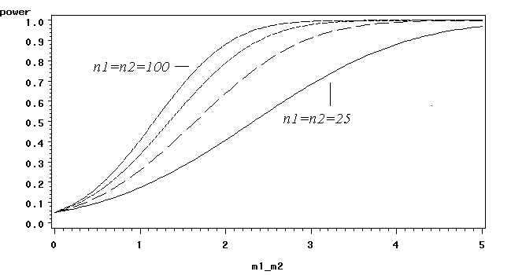
Power of a Test
Power Curves for group sample sizes of 25,50,75,100 and varying true values μ₁-μ₂ with σ₁=σ₂=5.
For given μ₁-μ₂ , power increases with sample size
For given sample size, power increases with μ₁-μ₂

Slide 88
Sample Size Calculations for Fixed Power
Goal - Choose sample sizes to have a favorable chance of detecting a clinically meaning difference
Step 1 - Define an important difference in means:
Case 1: σ approximated from prior experience or pilot study - dfference can be stated in units of the data
Case 2: σ unknown - difference must be stated in units of standard deviations of the data
Step 2 - Choose the desired power to detect the the clinically meaningful difference (1-β, typically at least .80). For 2-sided test:

Slide 89
Example - Rosiglitazone for HIV-1 Lipoatrophy
Trts - Rosiglitazone vs Placebo
Response - Change in Limb fat mass
Clinically Meaningful Difference - 0.5 (std dev’s)
Desired Power - 1-β = 0.80
Significance Level - α = 0.05
Source: Carr, et al (2004)

Slide 90
Confidence Intervals
Normally Distributed data - approximately 95% of individual measurements lie within 2 standard deviations of the mean
Difference between 2 sample means is approximately normally distributed in large samples (regardless of shape of distribution of individual measurements):
Thus, we can expect (with 95% confidence) that our sample mean difference lies within 2 standard errors of the true difference

Slide 91
(1-α)100% Confidence Interval for μ₁-μ₂
Large sample Confidence Interval for μ₁-μ₂:
Standard level of confidence is 95% (z_{.025} = 1.96 ≈ 2)
(1-α)100% CI’s and 2-sided tests reach the same conclusions regarding whether μ₁-μ₂= 0

Slide 92
Fundamental of Hypothesis Testing
There two types of statistical inferences, Estimation and Hypothesis Testing
Hypothesis Testing: A hypothesis is a claim (assumption) about one or more population parameters.
Average price of a six-pack in the U.S. is μ = $4.90
The population mean monthly cell phone bill of this city is: μ = $42
The average number of TV sets in U.S. Homes is equal to three; μ = 3

Slide 93
It Is always about a population parameter, not about a sample statistic
Sample evidence is used to assess the probability that the claim about the population parameter is true
A. It starts with Null Hypothesis, H₀
We begin with the assumption that H₀ is true and any difference between the sample statistic and true population parameter is due to chance and not a real (systematic) difference.
Similar to the notion of “innocent until proven guilty”
That is, “innocence” is a null hypothesis.

Slide 94
Null Hypo, Continued
Refers to the status quo
Always contains “=” , “≤” or “≥” sign
May or may not be rejected
B. Next we state the Alternative Hypothesis, H₁
Is the opposite of the null hypothesis
e.g., The average number of TV sets in U.S. homes is not equal to 3 ( H₁: μ ≠ 3 )
Challenges the status quo
Never contains the “=” , “≤” or “≥” sign
May or may not be proven
Is generally the hypothesis that the researcher is trying to prove. Evidence is always examined with respect to H₁, never with respect to H₀.
We never “accept” H₀, we either “reject” or “not reject” it

Slide 95
Summary:
In the process of hypothesis testing, the null hypothesis initially is assumed to be true
Data are gathered and examined to determine whether the evidence is strong enough with respect to the alternative hypothesis to reject the assumption.
In another words, the burden is placed on the researcher to show, using sample information, that the null hypothesis is false.
If the sample information is sufficient enough in favor of the alternative hypothesis, then the null hypothesis is rejected. This is the same as saying if the persecutor has enough evidence of guilt, the “innocence is rejected.
Of course, erroneous conclusions are possible, type I and type II errors.

Slide 96
Reason for Rejecting H₀
Illustration: Let say, we assume that average age in the US is 50 years (H0=50). If in fact this is the true (unknown) population mean, it is unlikely that we get a sample mean of 20. So, if we have a sample that produces an average of 20, them we reject that the null hypothesis that average age is 50. (note that we are rejecting our assumption or claim). (would we get 20 if the true population mean was 50? NO. That is why we reject 50)
How Is the Test done?
We use the distribution of a Test Statistic, such as Z or t as the criteria.

Slide 97
A. Rejection Region Method:
Divide the distribution into rejection and non-rejection regions
Defines the unlikely values of the sample statistic if the null hypothesis is true, the critical value(s)
Defines rejection region of the sampling distribution
Rejection region(s) is designated by α , (level of significance)
Typical values are .01, .05, or .10
α is selected by the researcher at the beginning
α provides the critical value(s) of the test

Slide 98
Rejection Region or Critical Value Approach:
Level of significance = α
Non-rejection region
Represents
critical value
a
H₀: μ = 12 H₁: μ ≠ 12
a
/2
/2
Two-tail test
0
H₀: μ ≤ 12 H₁: μ > 12
a
Rejection region is shaded
Upper-tail test
0
H₀: μ ≥ 12 H₁: μ < 12
a
Lower-tail test
0

Slide 99
P-Value Approach –
P-value=Max. Probability of (Type I Error), calculated from the sample.
Given the sample information what is the size of blue are?
H₀: μ = 12 H₁: μ ≠ 12
Two-tail test
0
H₀: μ ≤ 12 H₁: μ > 12
Upper-tail test
0
H₀: μ ≥ 12 H₁: μ < 12
0

Slide 100
Type I and II Errors:
The size of α , the rejection region, affects the risk of making different types of incorrect decisions.
Type I Error
Rejecting a true null hypothesis when it should NOT be rejected
Considered a serious type of error
The probability of Type I Error is α
It is also called level of significance of the test
Type II Error
Fail to reject a false null hypothesis that should have been rejected
The probability of Type II Error is β

Slide 102
Type I and Type II errors cannot happen at the same time
Type I error can only occur if H₀ is true
Type II error can only occur if H₀ is false
There is a tradeoff between type I and II errors. If the probability of type I error ( α ) increased, then the probability of type II error ( β ) declines.
When the difference between the hypothesized parameter and the actual true value is small, the probability of type two error (the non-rejection region) is larger.
Increasing the sample size, n, for a given level of α, reduces β

Slide 103
B. P-Value approach to Hypothesis Testing:
The rejection region approach allows you to examine evidence but restrict you to not more than a certain probability (say α = 5%) of rejecting a true H₀ by mistake.
The P-value approach allows you to use the information from the sample and then calculate the maximum probability of rejecting a true H₀ by mistake.
Another way of looking at P-value is the probability of observing a sample information of “A=11.5” when the true population parameter is “12=B”. The P-value is the maximum probability of such mistake taking place.

Slide 104
That is to say that P-value is the smallest value of α for which H₀ can be rejected based on the sample information
Convert Sample Statistic (e.g., sample mean) to Test Statistic (e.g., Z statistic )
Obtain the p-value from a table or computer
Compare the p-value with α
If p-value < α , reject H₀
If p-value ≥ α , do not reject H₀

Slide 105
Test of Hypothesis for the Mean
σ known
σ Unknown
The test statistic is:
The test statistic is:

Slide 106
Steps to Hypothesis Testing
State the H₀ and H₁ clearly
Identify the test statistic (two-tail, one-tail, and Z or t distribution
Depending on the type of risk you are willing to take, specify the level of significance,
Find the decision rule, critical values, and rejection regions. If –CV<actual value (sample statistic) <+CV, then do not reject the H₀
Collect the data and do the calculation for the actual values of the test statistic from the sample

Slide 107
Steps to Hypothesis testing, continued
Make statistical decision
Do not Reject H₀
Reject H₀
Conclude H₀ may be true
Conclude H₁ is “true”
(There is sufficient evidence of H1)
Make management/business/administrative decision

Slide 108
When do we use a two-tail test? when do we use a one-tail test?
The answer depends on the question you are trying to answer.
A two-tail is used when the researcher has no idea which direction the study will go, interested in both direction. (example: testing a new technique, a new product, a new theory and we don’t know the direction)
A new machine is producing 12 fluid once can of soft drink. The quality control manager is concern with cans containing too much or too little. Then, the test is a two-tailed test. That is the two rejection regions in tails is most likely (higher probability) to provide evidence of H_{1.}
12

Slide 109
One-tail test is used when the researcher is interested in the direction.
Example: The soft-drink company puts a label on cans claiming they contain 12 oz. A consumer advocate desires to test this statement. She would assume that each can contains at least 12 oz and tries to find evidence to the contrary. That is, she examines the evidence for less than 12 0z.
What tail of the distribution is the most logical (higher probability) to find that evidence? The only way to reject the claim is to get evidence of less than 12 oz, left tail.
11.5
12
14

Slide 110
Review of Hypo. Testing
What is HT?
Probability of making erroneous conclusions
Type I – only when Null Hypo is true
Type II – only when Null Hypo is false
Two Approaches
The Rejection or Critical Value Approach
The P-value Approach (we calculate the observed level of significance)
Test Statistics
Z- distribution if Population Std. Dev. is Know
t-distribution if the Population Std. Dev. is unknown

Slide 111
Rejection Region or Critical Value Approach:
The given level of significance = α
Non-rejection region
Represents
critical value
a
H₀: μ = 12 H₁: μ ≠ 12
a
/2
/2
Two-tail test
0
H₀: μ ≤ 12 H₁: μ > 12
a
Rejection region is shaded
Upper-tail test
0
H₀: μ ≥ 12 H₁: μ < 12
a
Lower-tail test
0

Slide 112
P-Value Approach –
P-value=Max. Probability of (Type I Error), calculated from the sample.
Given the sample information what is the size of the blue areas? (The observed level of significance)
H₀: μ = 12 H₁: μ ≠ 12
Two-tail test
0
H₀: μ ≤ 12 H₁: μ > 12
Upper-tail test
0
H₀: μ ≥ 12 H₁: μ < 12
0

Slide 113
Example 1:
Let’s assume a sample of 25 cans produced a sample mean of 11.5 0z and the population std dev=1 0z.
Question 1:
At a 5% level of significance (that is allowing for a maximum of 5% prob. of rejecting a true null hypo), is there evidence that the population mean is different from 12 oz?
Null Hypo is:?
Alternative Hypo is?
Can both approaches be used to answer this question?

Slide 114
A: Rejection region approach: calculate the actual test statistics and compare it with the critical values
B: P-value approach: calculate the actual probability of type I error given the sample information. Then compare it with 1%, 5%, or 10% level of significance.
Interpretation of Critical Value/Rejection Region Approach:
Interpretation of P-value Approach:
Notes:
With 5% probability of making type I error or at 5% level of significance, there is sufficient evidence that the pop mean is different from 12, thus, we reject the null hypo that it is equal to 12.
If in fact the pop. mean is 12 oz, the probability of getting a sample with mean equal to 11.5 oz (0.5 or more away from 12 in either side) is .0124.

Slide 115
Question 2:
At a 5% level of significance (that is allowing for a maximum of 5% prob. of rejecting a true null hypo), is the evidence that the population mean is less than 12 oz?
Null Hypo is:?
Alternative Hypo is?
Can both approaches be used to answer this question?
Interpretation of Critical Value Approach:
Interpretation of P-value Approach:
Notes:
With 5% risk of type I error or at 5% level of significance, there is sufficient evidence that the pop mean is less than 12, thus, we reject the null hypo that it s equal to or greater than 12.
If in fact the pop. mean is 12 oz, the probability of getting a sample with mean equal to 11.5 or less oz (0.5 or more smaller than 12) is .0062.

Slide 116
Question 3:
If in fact the pop. mean is 12 oz, what is the probability of obtaining a sample mean of 11.5 or less oz (sample size 25)? Null
Null Hypo is:?
Alternative Hypo is?
Question 4:
If in fact the pop. mean is 12 oz, and the sample mean is 11.5 (or less), what is the probability of erroneously rejecting the null hypo that the pop. mean is 12 oz?
Null Hypo is:?
Alternative Hypo is?
Can both approaches be used to answer these question?

Slide 117
Connection to Confidence Intervals
While the confidence interval estimation and hypothesis testing serve different purposes, they are based on same concept and conclusions reached by two methods are consistent for a two-tail test.
In CI method we estimate an interval for the population mean with a degree of confidence. If the estimated interval contains the hypothesized value under the hypothesis testing, then this is equivalent of not rejecting the null hypothesis. For example: for the beer sample with mean 5.20, the confidence interval is:
P(4.61 ≤ μ ≤ 5.78)=95%
Since this interval contains the Hypothesized mean ($4.90), we do not (did not) reject the null hypothesis at α = .05
Did not reject and within the interval, thus consistent results.

Slide 118
Summary of Hypothesis Tests for Differences
Sample
Application
Level of Scaling
Test/Comments
One Sample
Proportion
Metric
Z test
One Sample
Means
Metric
t
test, if variance is unknown
z
test, if variance is known

Slide 119
Summary of Hypothesis Tests for Differences
Two Indep Samples
Application
Scaling
Test/Comments
Two indep samples
Means
Metric
Two
-
group
t
test
F
test for equality of
variances
Two indep samples
Proportions
Metric
z
test
Nonmetric
Chi
-
square test

